Slide 1
Pythton Classses

Slide 2
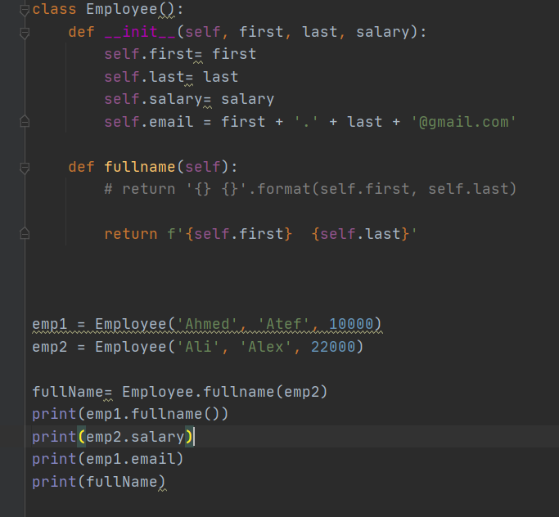
Attributes
Methods

Slide 3
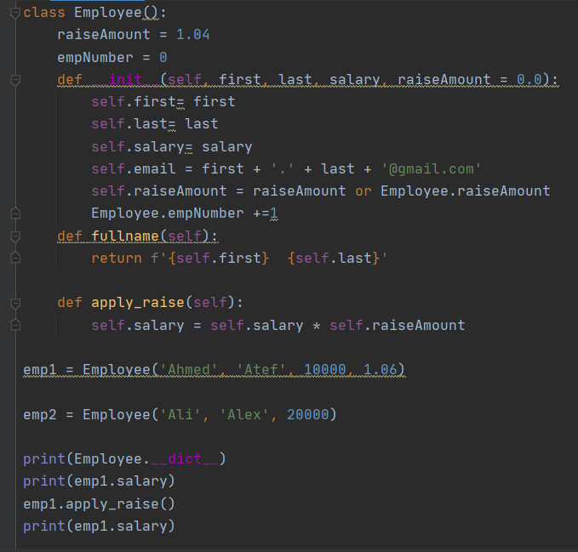
Class instance

Slide 4
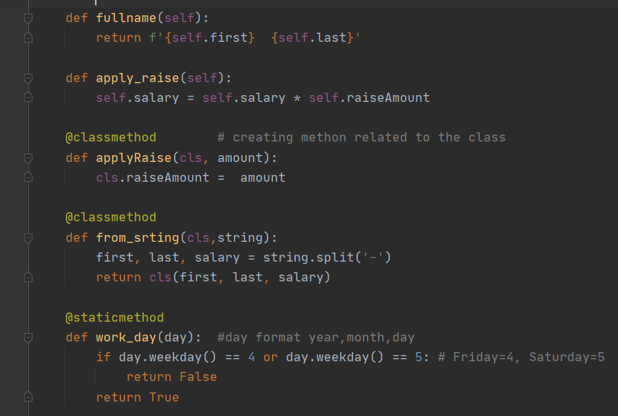
Class method
Static method

Slide 5
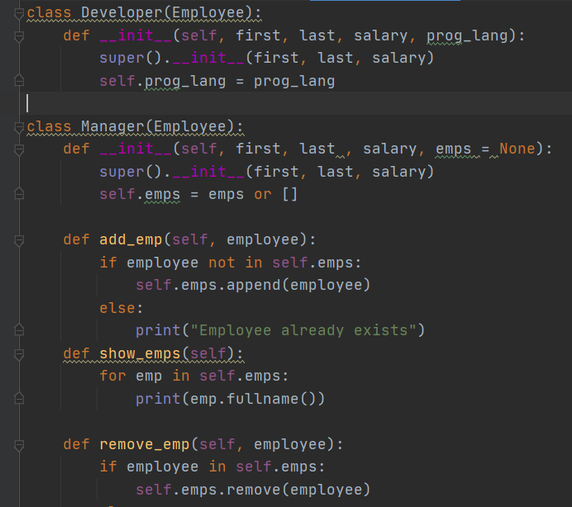
Inheritance

Slide 6
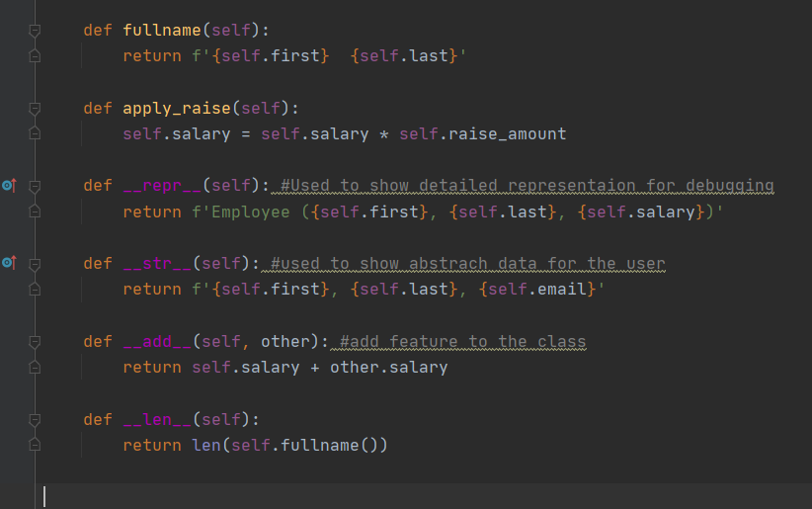
Magic methods

Slide 7
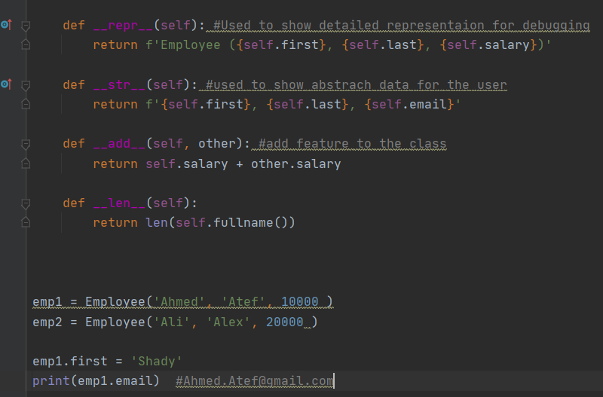
Email not edited

Slide 8
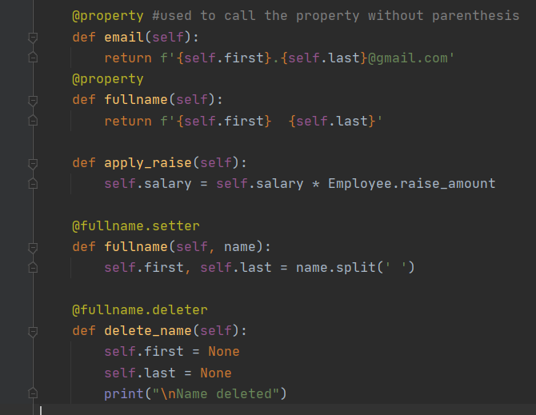
Email property decorator
Setter decorator
Deleter decorator

